Slide 1
Data-driven Interior Plan Generation for Residential Buildings
Wenming Wu¹ Xiao-Ming Fu¹ Rui Tang² Yuhan Wang² Yu-Hao Qi¹ Ligang Liu¹
¹University of Science and Technology of China ²Kujiale
Notes:
Good morning everyone. Thank you so much for coming to my talk.
I am Wenming Wu and I am presenting our work titled “Data-driven Interior Plan Generation for Residential Buildings”.
It is joint work between USTC and Kujiale.

Slide 2
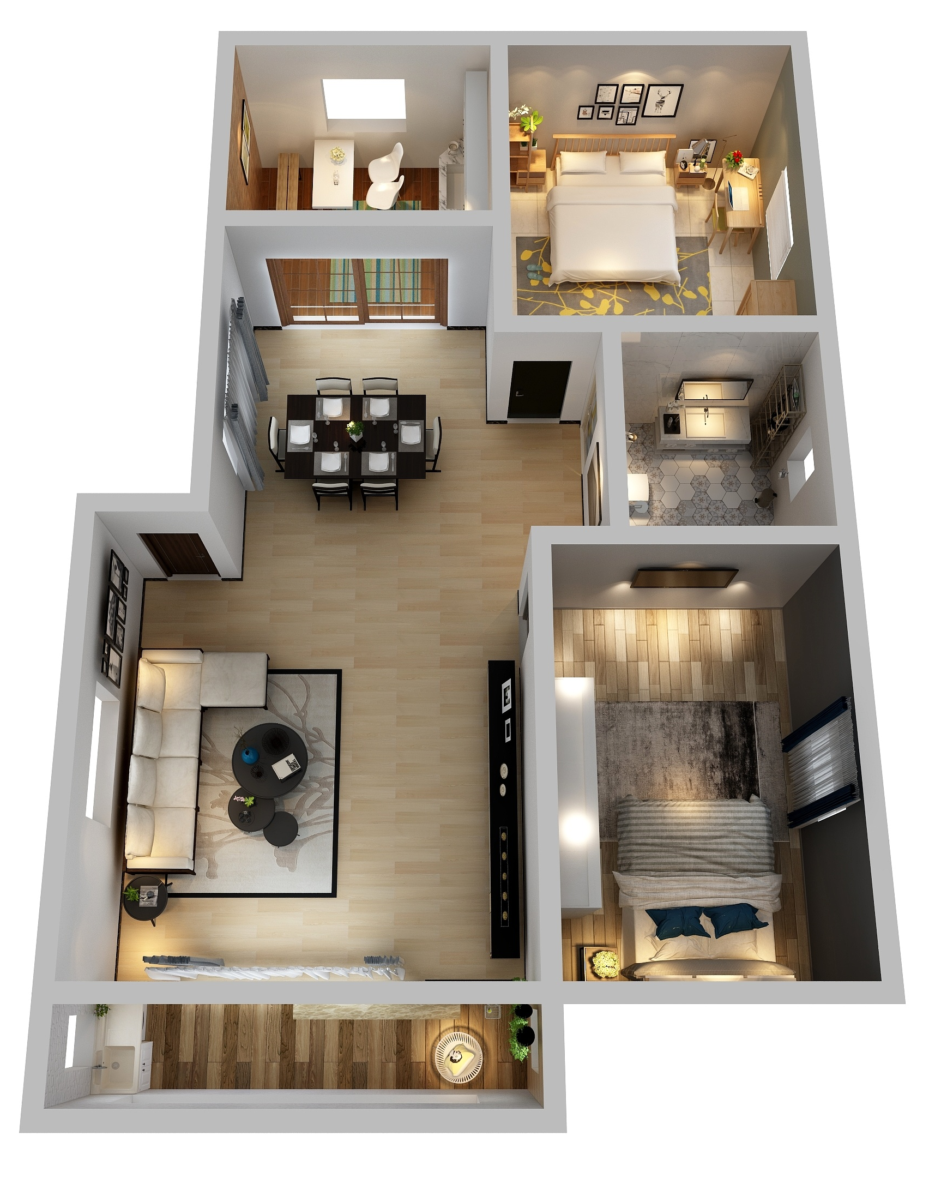
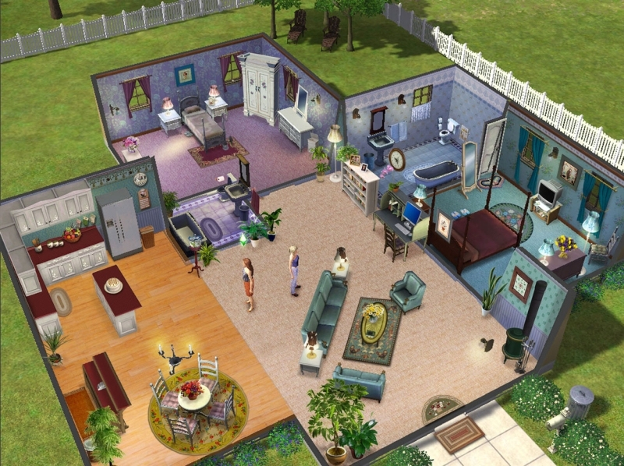
Interior plan
Designing floor plans for residential buildings
Architectural scenes in computer games and virtual worlds
House design
Computer game
Notes:
Interior plans are urgently demanded in many computer graphics applications, such as house design and computer games.
Modern computer games and social virtual worlds usually have large architectural scenes with residential buildings that allow users to enter and explore.

Slide 3
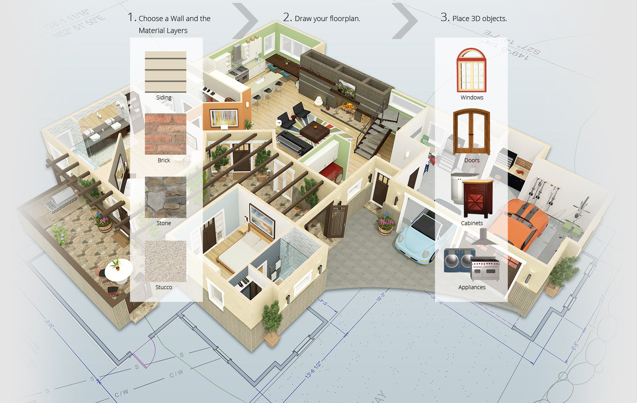
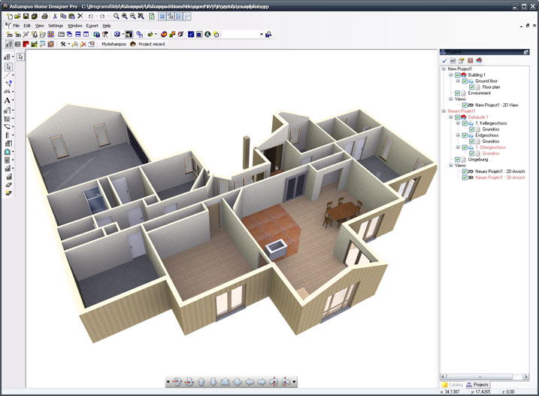
Motivation
An iterative trial-and-error and time-consuming process
Interactive tool
Assistant tool
Notes:
Such interior plans are manually created by professional designers.
Even with interactive assistant tools, the design process is trial-and-error as well as time-consuming since it requires significant expertise, experience, and intuition.

Slide 4
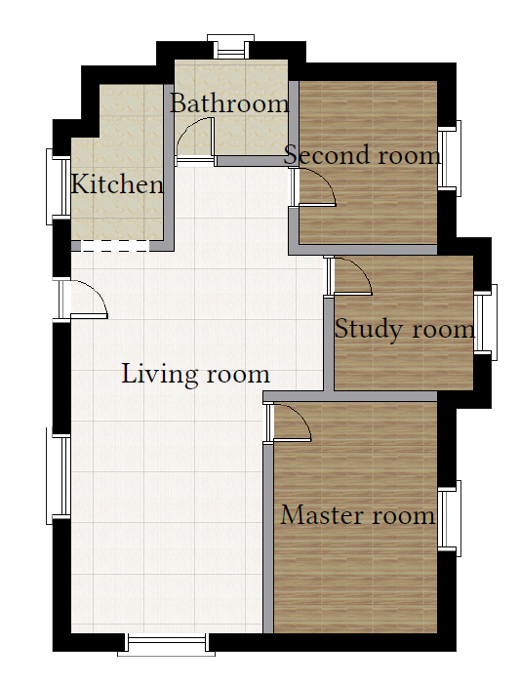

Goal: automatic generation
Automate design for residential buildings
Quick and high-quality generation
Plausible floor plan
Notes:
We try to automate the design process of interior plan for residential buildings.
Moreover, we would like to quickly generate high-quality floor plans.

Slide 5
Related work
Computer-generated residential building layouts [Merrell et al. 2010]
Computing layouts with deformable templates [Peng et al. 2014]
MIQP‐based Layout Design for Building Interiors [Wu et al. 2018]
More ...
Notes:
Some techniques have been proposed for this goal in computer graphics.
Most of them try to solve the constraint-based systems with high-level requirements, such as room sizes, positions, and adjacencies.
However, existing optimization-based methods have problems of complicated constraint design and low optimization efficiency.
These constraints are highly dependent on the knowledge of the individual designers.

Slide 6
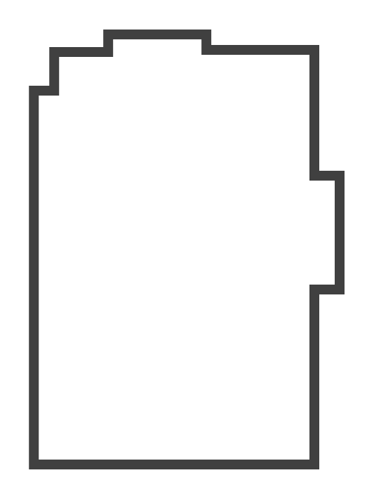
Problem statement
Generate ﬂoor plans given the building boundary as input
Input floor plan
Output floor plan
Notes:
In our case, we take the building boundary as input and the only constraint.
We reiterate our problem statement as follows.
Given the building boundary as input, how to automatically and efficiently generate floor plans?

Slide 7






Problem statement
A data-driven method for floor plan generation
Data-driven
Input floor plan
Output floor plan
Notes:
This problem is particularly challenging. Since floor plans of residential buildings are not highly regular, it is difficult to precisely defined the objectives.
Besides, it is non-trivial to find the required high-level constraints. Therefore, learning the human-created floor plans is a promising way.

Slide 8

Challenges
A large-scale dataset consisting of real ﬂoor plans with annotations
A non-trivial learning approach to generate high-quality floor plans
Dataset
Network
Notes:
So now our goal is to find a data-driven method for interior plan generation.
The first challenge is that a large-scale dataset of floor plans is expected. However, there is no such dataset yet.
Secondly, it is non-trivial to design a highly individualized learning approach that can generate high-quality floor plans.
[3min]

Slide 9
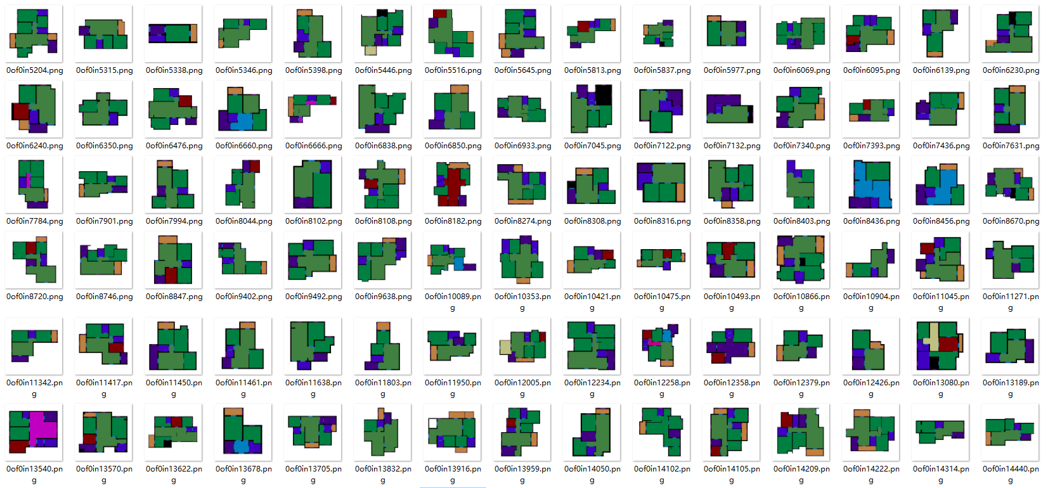
Dataset of RPLAN
A large-scale dataset containing more than 80K real-world ﬂoor plans
Notes:
To solve the data problem, we propose a large-scale dataset of floor plans from real residential buildings.
To enhance the reliability of collected data, we filter out some of the non-standard floor plans.
Finally we are left with more than 80K floor plans in our dataset.

Slide 10
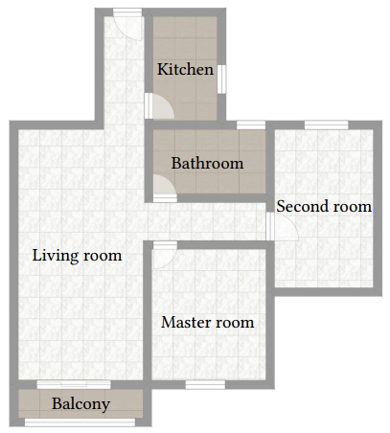
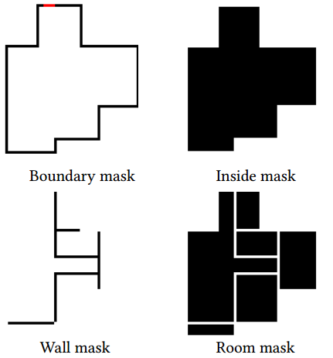
Data representation
A four-channel image (256x256) represent a squared region (18mx18m)
Floor plan
Ground truth
Notes:
We represent each floor plan in our dataset as a four-channel image.
They are the boundary mask, the inside area mask, the interior wall mask, and the room mask.

Slide 11
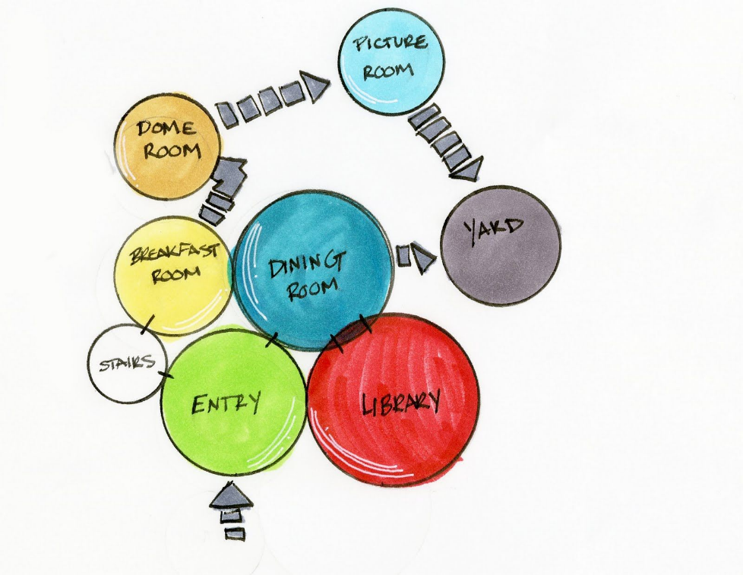
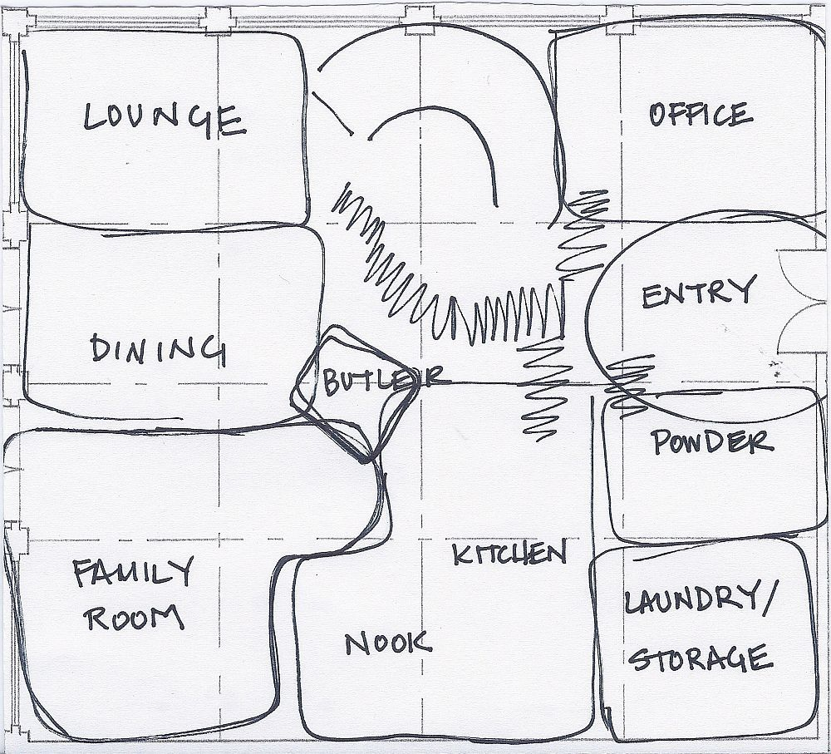
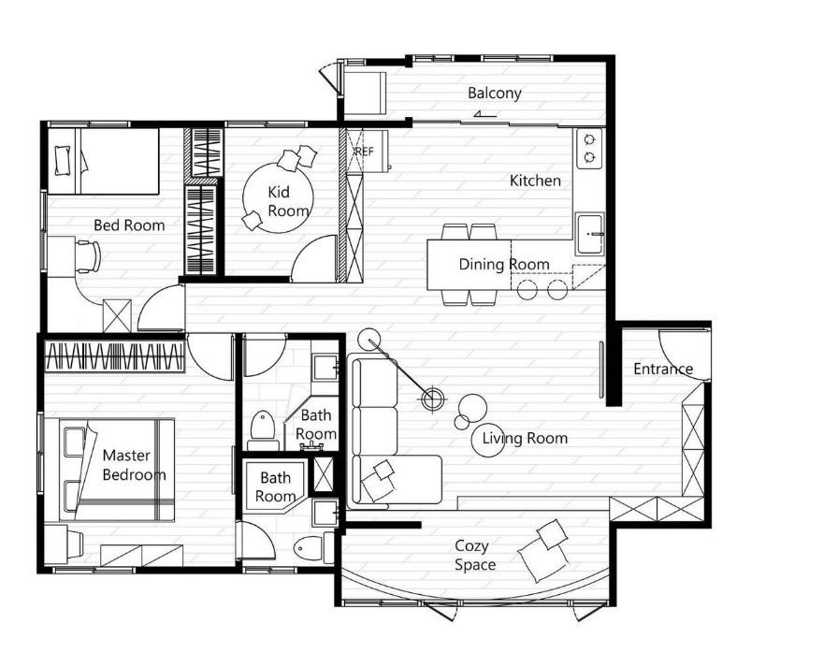
Design process of designers
Determining room connections and positions
Computing room sizes and wall positions
Bubble graph
Initial draft
Final design
Notes:
To develop a learning based method, we study the design process of interior plan as it is carried out by residential designers in practice.
The whole design process begins with a simple sketch diagram, called bubble graph and an initial draft is developed based on the bubble graph. Then the initial draft is further refined to form the final design.
An important observation is that designers basically adopt two steps in the design process: first determining room connections and room positions, and then computing room sizes and wall positions.

Slide 12
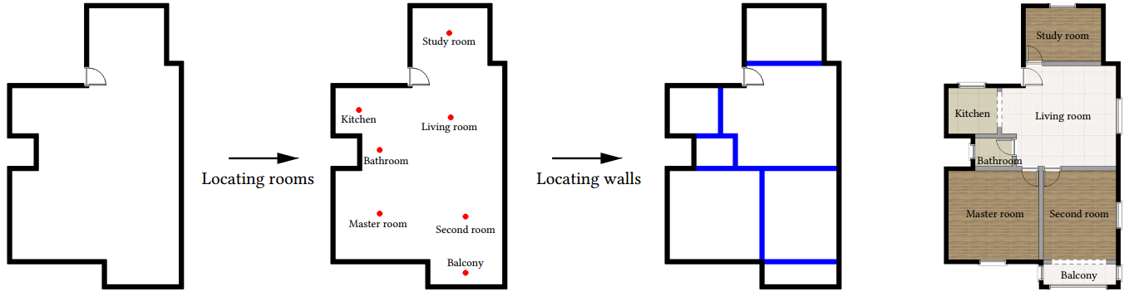
Approach
A two-stage approach that imitates the human design process by
locating rooms first and then walls
Two-stage approach
Notes:
We propose a two-stage approach that imitates the human design process.
Given the building boundary as input, our method first uses an iterative prediction model to obtain room locations, and then further locates walls to obtain a vectorized floor plan.
Additional details, including doors and windows, are added to visualize the results.

Slide 13
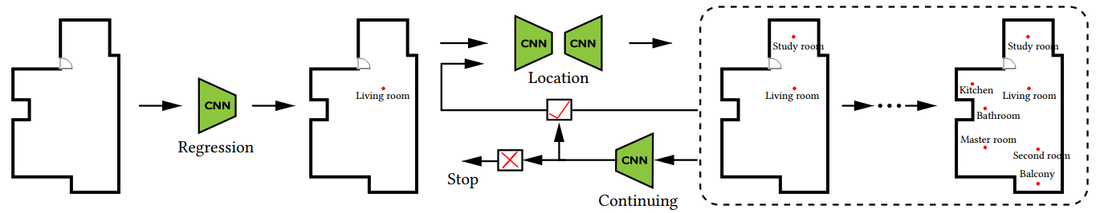
Stage one: locating rooms
Iterative strategy:
(1) Computing the location of the living room
(2) Deciding what type of room to add and where
(3) Deciding whether to add another room.
If yes, go to Step (2); otherwise stop the algorithm
Notes:
The first stage is to locate rooms. Given the building boundary as input, our method first adopts a regression network to choose a location for the living room.
Then a location network and a continuing network are iteratively used to predict the types and locations of other rooms.
The iterative process stops when the continuing network decides not to add rooms anymore.

Slide 14
Living room first strategy
Living room first strategy:
An indispensable part in the modern residence
Located in the central area of the floor plan
Connected to most other rooms
Notes:
The living room is an indispensable part in the modern residence and there are two key features:
it is usually located in the central area and connected to most other rooms.
We then develop a living room first strategy, which predicts the location of the living room first.
A separated prediction model for the living room helps to improve the overall rationality of the floor plan.

Slide 15
Room type and location
An encoder-decoder network to predict room types and locations
An iterative process to add rooms into the scene
Notes:
Given the predicted living room, we then use an encoder-decoder network to determine room types and locations.
Specifically, the current scene serves as the input of our encoder-decoder network to predict a new room. Each time we only add one room into the current scene to obtain the new scene.
This iterative process continues adding rooms, so we need to determine whether to terminate the algorithm. Then we develop a continuing network to determine whether to add a room into the current scene.

Slide 16
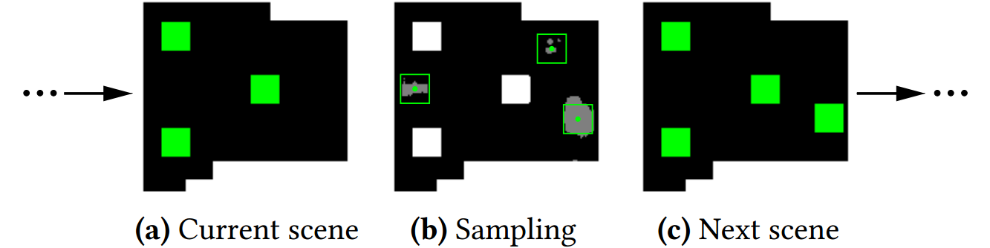
Sampling
A robust sampling method to reduce the impact of the noise
Notes:
Since such prior locating process is often noisy, we adopt a robust sampling method.
For each pixel with a room label in the prediction map, we compute the number of pixels, which have the same label in the neighborhood.
We choose the location of the pixel that has the greatest number as the center of the new room.
[8.5min]

Slide 17
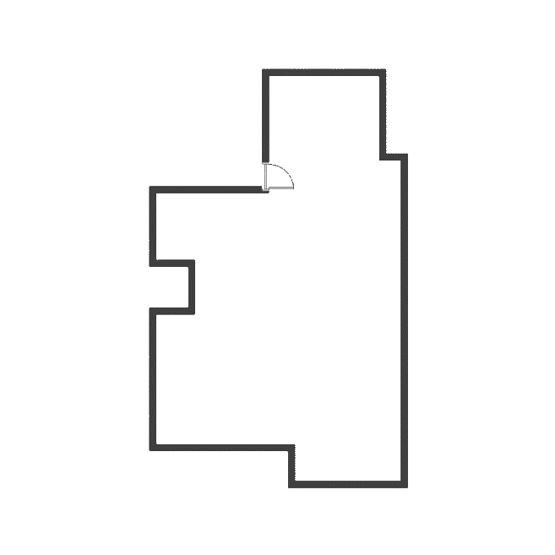
Locating rooms
Location
Study room
Regression
CNN
CNN
Kitchen
Living room
Living room
CNN
Bathroom
yes
Second room
go on
Master room
CNN
Balcony
no
Continuing
Stop
Notes:
Here is a demo of the whole process, incluing the living room regression network, the room locating network and the
continuing network.

Slide 18
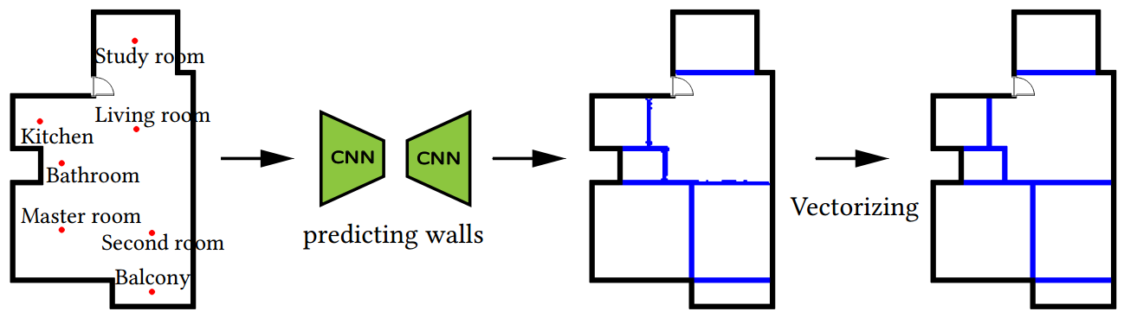
Stage two: locating walls
A prediction-based wall locating strategy
Notes:
The next stage is to locate walls to allocate space for each room. We propose a prediction-based wall locating strategy.
We first use an encoder-decoder network to predict walls in discrete pixels based on the location map of the first stage.
Then a post-processing step is applied to convert the predicted walls into a vector representation.

Slide 19
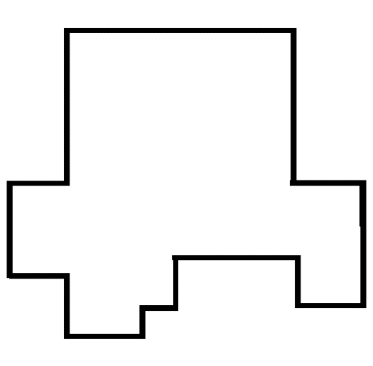

Encoder-decoder prediction
Locating rooms
Locating walls
Notes:
Pixels on the image of a floor plan can be divided into two categories, wall and non-wall. In this way, the wall prediction becomes a binary classification problem.
We use the same network architecture as in the room locating network due to the similar pixel-classification tasks.
The encoder-decoder network performs pixel-level prediction based on the location map to obtain the position of walls.

Slide 20
Vectorization
Convert the predicted wall map into the final vector format
Post-processing
Notes:
Our network generates a wall map with discrete pixels representing walls. We then use a post-processing step to convert the wall map into a vector representation.

Slide 21
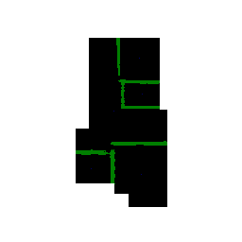
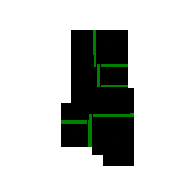
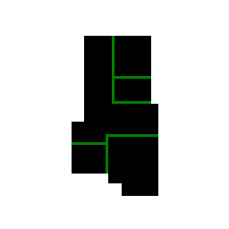
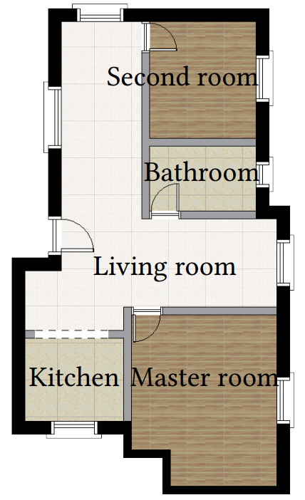
Vectorization
Convert the predicted wall map into the final vector format
Notes:
We first decompose and fit the noise predicted walls into rectangular parts, and then connect and align the wall blocks to recover the complete walls.
We obtain the label for each pixel based on the predicted rooms and recovered walls.
Finally, we use several empirical rules to place the doors and windows.
[10.5min]

Slide 22
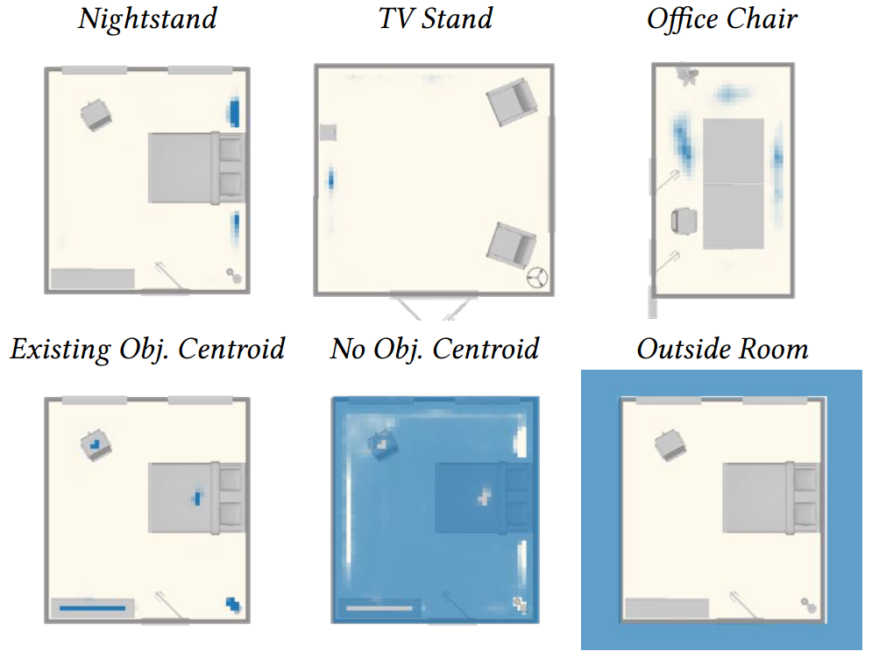
User study
State-of-the-art methods for layout synthesis in computer graphics
Wu et al. 2018
MIQP
Wang et al. 2018
ISSNet
Notes:
We select state-of-the-art methods as the competitors.
Given the room locations, the MIQP-based method can be used to locate walls. We call it MIQP.
The networks for indoor scene synthesis can be used to locate rooms. We call it ISSNet.

Slide 23
User study
Cross combination between state-of-the-art methods and our method to construct our competitors
(1) ISSNet+MIQP: [Wang et al. 2018] + [Wu et al. 2018]
(2) Stage1+MIQP: Our networks for locating rooms + [Wu et al. 2018]
(3) ISSNet+Stage2: [Wang et al. 2018] + Our network for locating walls
(4) Human: Human-created floor plans
Notes:
We further construct four competitors by cross combination between state-of-the-art methods and our method.
As shown in this slide.

Slide 24
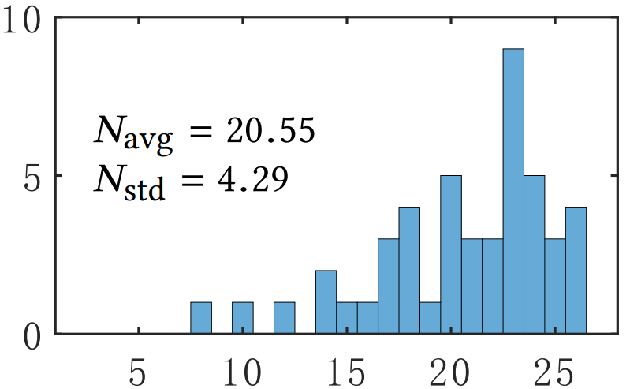
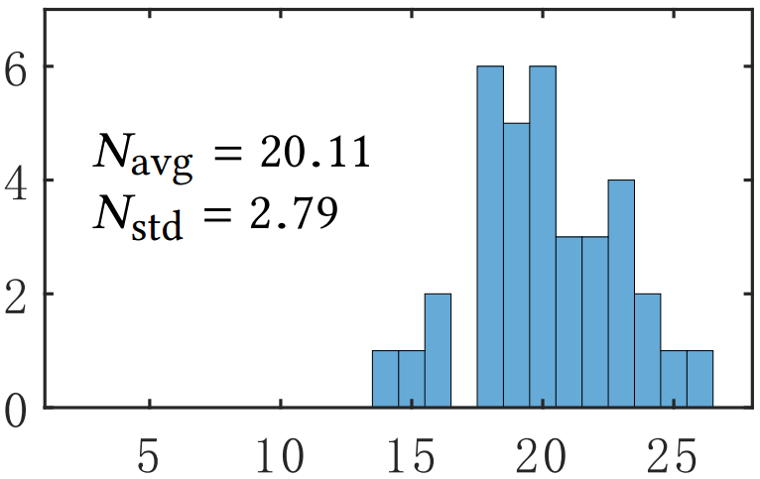
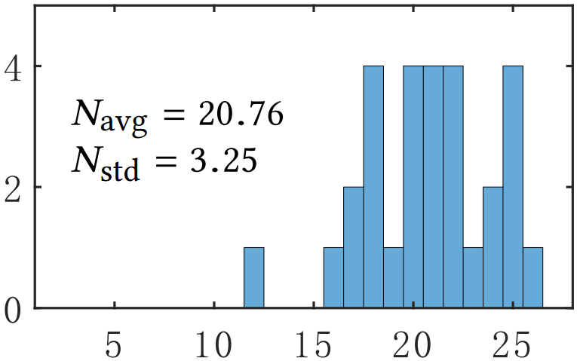
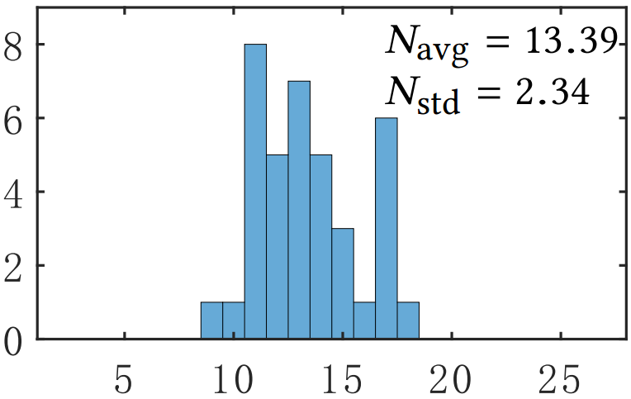
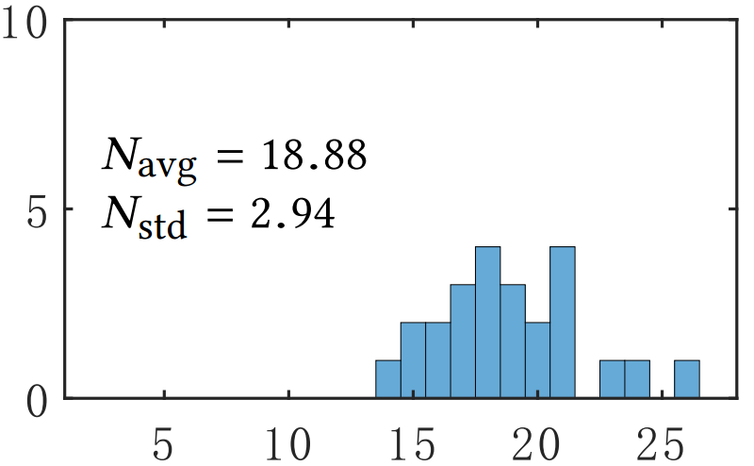
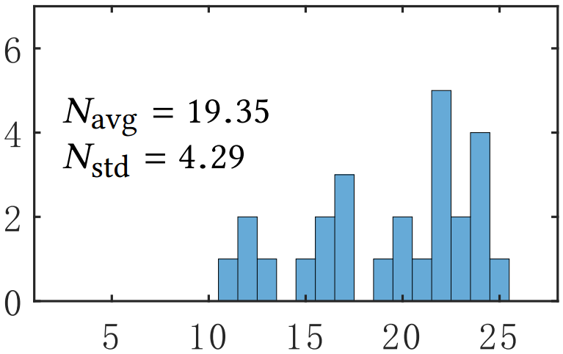
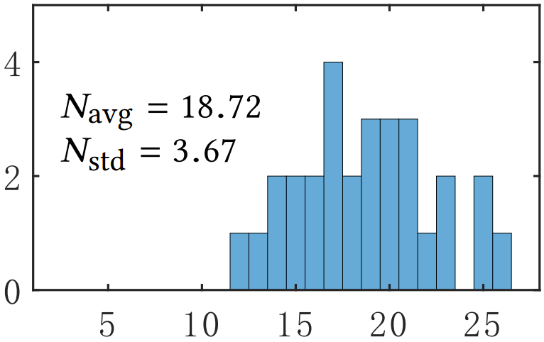
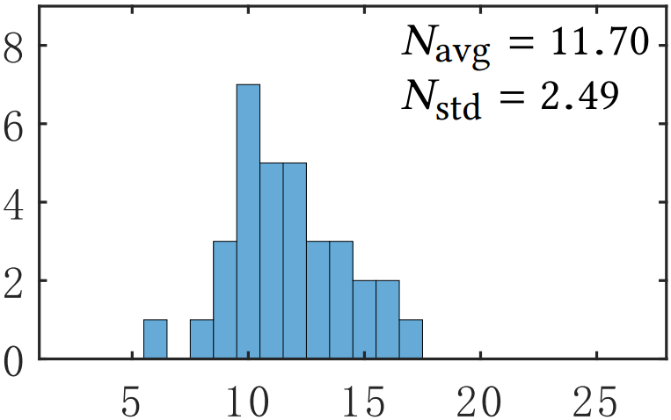
User study
Distributions of the number of ﬂoor plans that are generated by our method and preferred by that participant
General Users
Designers
ISSNet+MIQP
Stage1+MIQP
ISSNet+Stage2
Human
Notes:
Given a pair of floor plans with the same boundary, the forced-choice comparison task is designed. The participants are classified into general users and designers.
For each participant, we record the number of floor plans that are generated by our method and preferred by that participant. From the distributions, our method is comparable to Human and outperforms the other three competitors.

Slide 25
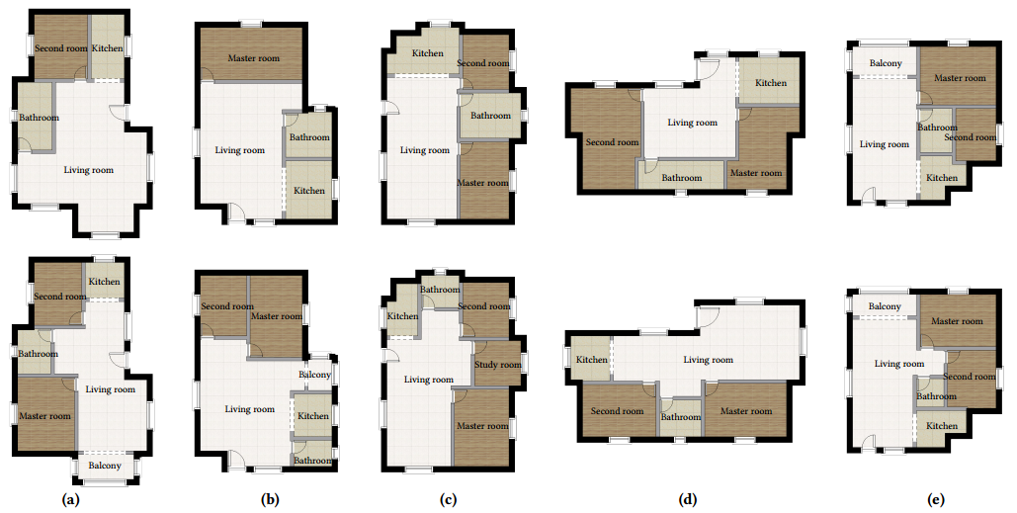

Comparison to ISSNet+MIQP
Competitor
Our method
Notes:
Next I will give more details of the result analysis.
ISSNet+MIQP synthesizes some rooms with unreasonable sizes, such as the bathroom in column (d).
In column (e), ISSNet+MIQP synthesizes a floor plan where the second room is blocked by the bathroom.

Slide 26
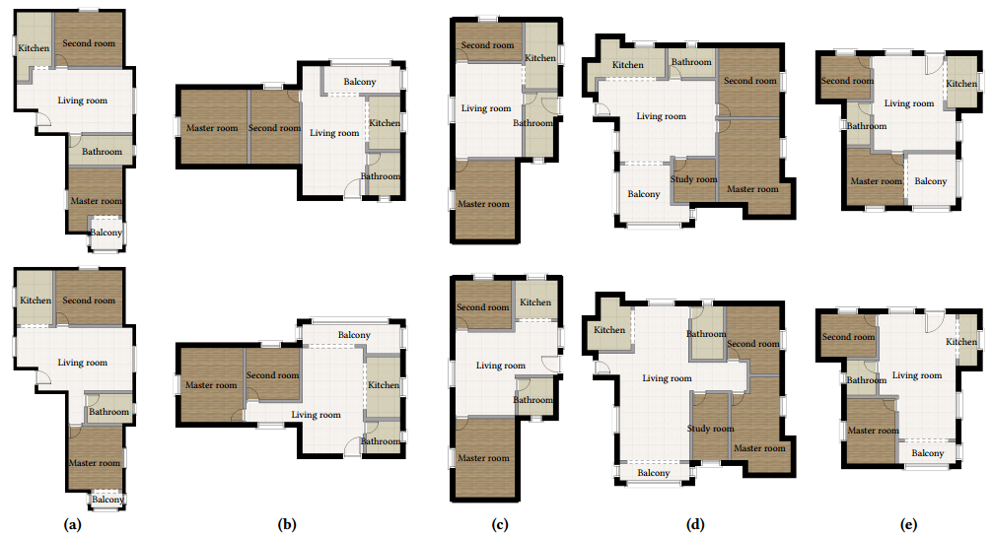
Comparison to Stage1+MIQP
Competitor
Our method
Notes:
When comparing to Stage1+MIQP, column (c) show the connection problem of Stage1+MIQP.
The entrance, which should be connected to the living room, is incorrectly connected to the bathroom.
The balcony in column (e) generated by Stage1+MIQP is much larger than normal.

Slide 27
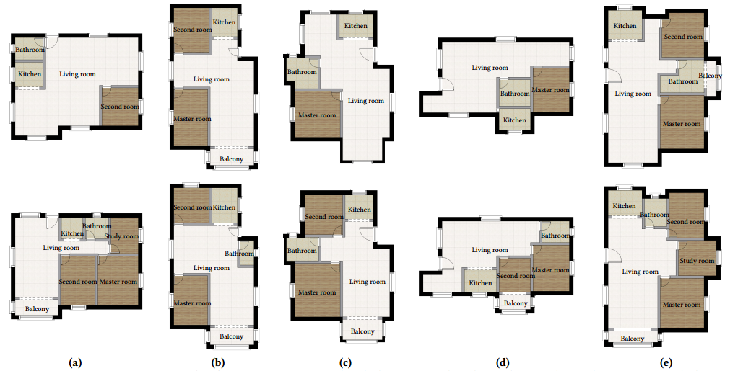
Comparison to ISSNet+Stage2
Competitor
Our method
Notes:
ISSNet+Stage2 has the global consistency problem, which causes that some necessary rooms are omitted. For example, it neglects to add a master room in column (a).
In column (e), ISSNet+Stage2 synthesizes an abnormal floor plan where the balcony is connected to the bathroom, which violates the privacy of the bathroom.

Slide 28
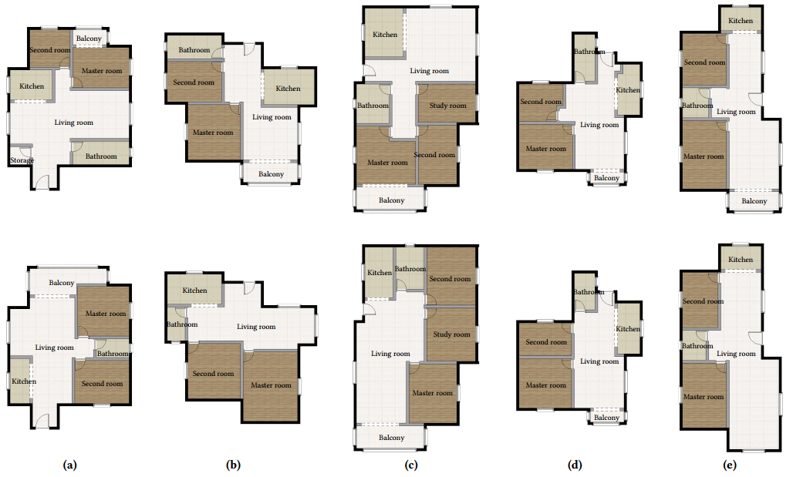
Comparison to Human
Competitor
Our method
Notes:
We finally compare the floor plans generated by our method with original floor plans from our dataset.
Columns (d) and (e) illustrate that our method can synthesize floor plans similar to those created by humans with only few diﬀerences, which proves the validity of our method.
For columns (a), (b), and (c), our method provides different design options compared to the human-created floor plans.

Slide 29
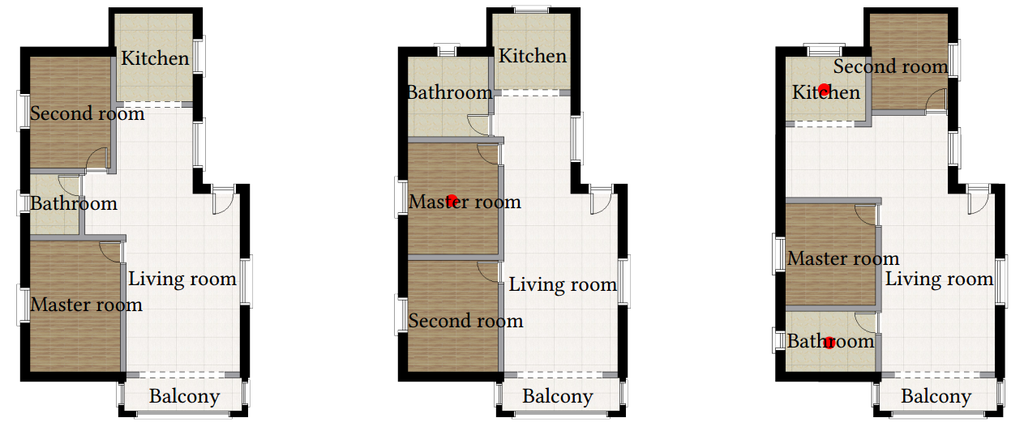
Room constraints
Examples of floor plans generated by our method, given one or two room locations specified by users
Notes:
I will show more results of our method.
First of all, our method support the location constraint that specifies the locations of some rooms.
Here are several examples generated by our method, given one or two room locations specified by users.

Slide 30
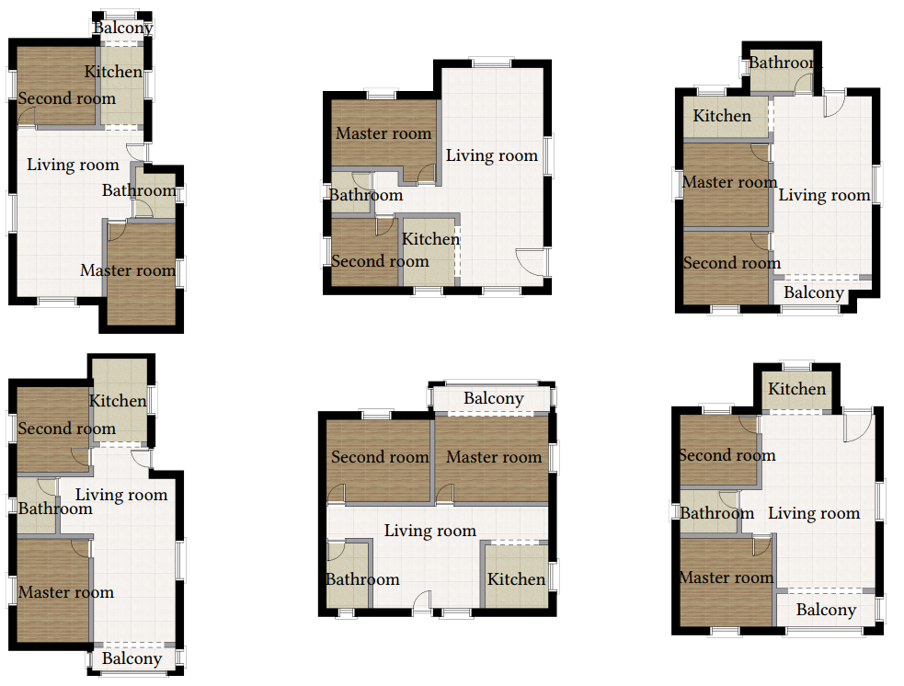
Nearest neighbors
The nearest neighbors
Our synthesized results
Notes:
We also examine the ability of our method to synthesize floor plans beyond its training dataset, which does not just memorize the training dataset.
Given the builidng boundary as input, we first synthesize our result and use the building boundary to search the nearest neighbor in the training dataset.
All of our results are different from the nearest neighbors.

Slide 31
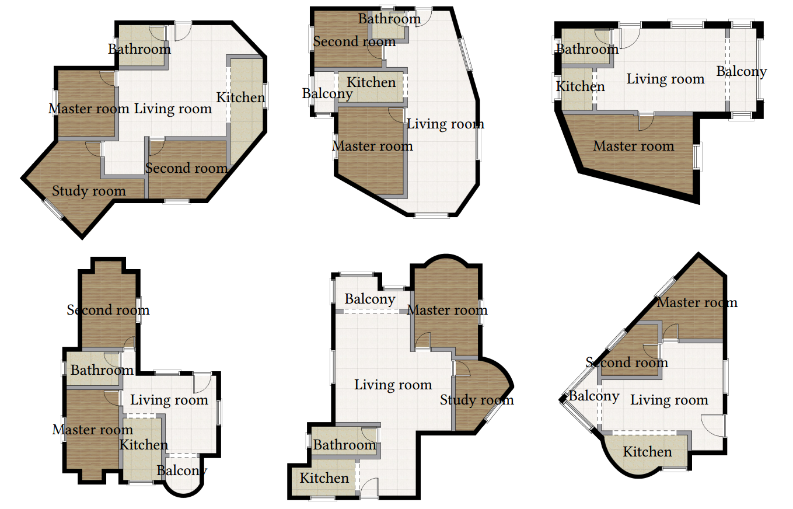
Non axis-aligned input
Floor plan generation for non axis-aligned boundaries
Notes:
Although our dataset only contains floor plans with axis-aligned walls, our method still works well when the building boundary is non axis-aligned.
Here are several examples generated by our method for non axis-aligned boundaries.
This indicates that our method synthesizes floor plans beyond its training dataset.

Slide 32
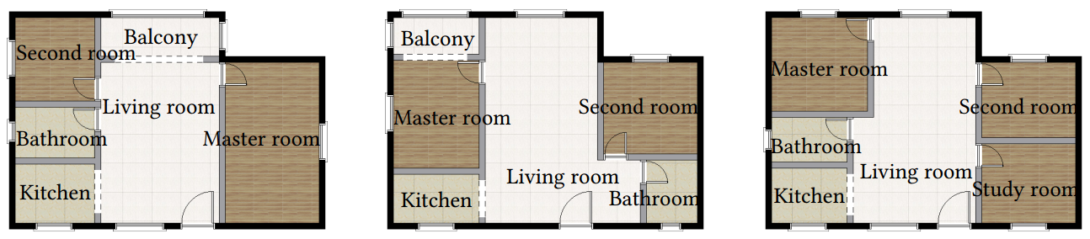
Multiple ﬂoor plans
Synthesize multiple floor plans given the same boundary as input
Notes:
Our method can also synthesize multiple floor plans given the same boundary as input.
[16.5min]

Slide 33
Conclusion
A novel data-driven technique to generate ﬂoor plans for residential buildings with fixed boundary
A large-scale dataset containing more than 80K ﬂoor plans from
real residential buildings
Notes:
In conclusion, we propose a novel data-driven technique for automatically and efficiently generating floor plans for residential buildings with fixed boundary.
By imitating the human design process, we propose a two-stage approach to generate floor plans.
To eﬀectively train our networks, a large-scale dataset containing more than 80K floor plans from real residential buildings is presented.

Slide 34
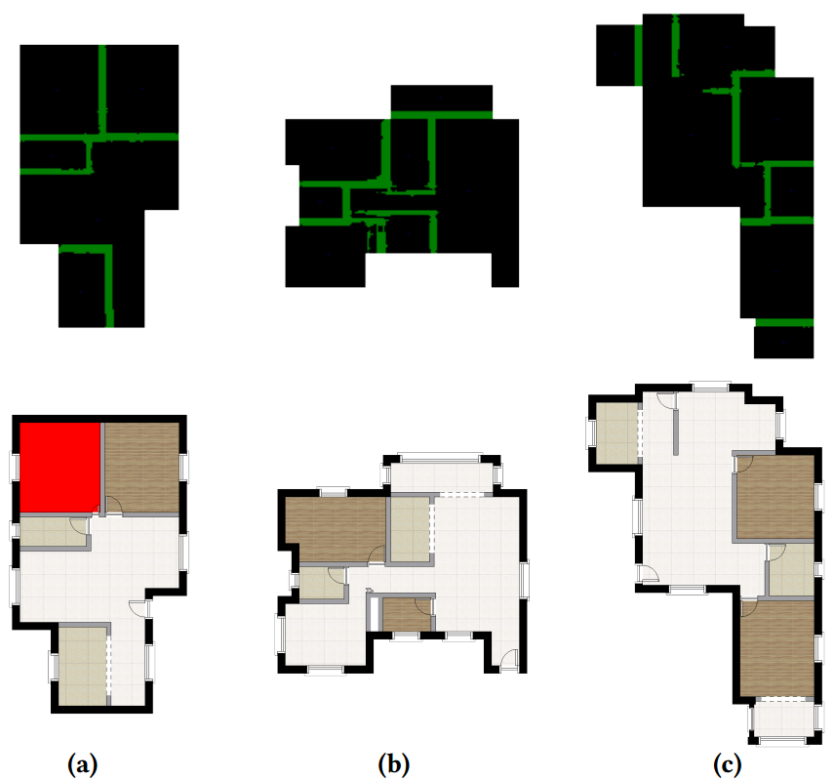
Conclusion
Limitations
Inappropriate arrangements
Poor wall predictions
Problematic vectorization
Future work
Constraints in real life
More types of buildings
Failure case
Notes:
While our method generates plausible floor plans, it does fail in some cases.
Our method may generate some results with inappropriate arrangements and poor wall predictions.
Our network predicts walls with noise and pixel missing, which is difficult to deal with in post-processing.
In practice, design with additional constraints seems to be more meaningful and challenging. We would like to explore more in the future.
Our two-stage approach can also be extended to other types of buildings, such as office buildings, shopping malls, and supermarkets.

Slide 35
Acknowledgements
All participants of user studies
Kai Wang[Wang et al. 2018]), Brown University
All anonymous reviewers
All funding agencies
Notes:
We would like to thank all user study participants for evaluating our results, Kai Wang for providing their implementation, all the anonymous reviewers for their constructive suggestions and comments.
And all funding agencies for their contribution to this project.

Slide 36
Thank you
Wenming Wu
Notes:
Thanks for your attention. Thank you.
[19min]

